Slide 1
SOURCE CODE MANAGEMENT
Team Details :
Hardik Saluja – 2410991306
Harsh – 2410991314
Harsh Gupta – 241099131
Hemant Joshi – 2410991341
Saksham Jain - 2410991382
Faculty Coordinator:
Dr. Sunil Gupta (Associate Professor)
Chitkara University Institute of Engineering and Technology, Chitkara University, Punjab

Slide 2
Table of Contents
Project Overview
Technology Stack
Installation & Setup
Usage
Version Control with GIT
Features
Contribution

Slide 3

Introduction
Title: Event Listing Website
Team Members:
Hardik Saluja – 2410991306
Harsh – 2410991314
Harsh Gupta – 241099131
Hemant Joshi – 2410991341
Saksham Jain - 2410991382
Description:
Our university event listing website is an intuitive and user-friendly platform that allows students and faculty to browse a wide range of campus events and activities, register for them, and stay updated in real-time. The website features a streamlined event discovery system, personalized recommendations, and an easy registration process. Users can also view ratings and reviews of past events, ensuring a more engaging and well-informed campus experience.

Slide 4
Technology Stack
Components | Technology
Frontend | HTML, CSS, JAVASCRIPT
Version Control | GIT and GitHub
Hosting | GitHub Pages
The frontend of a website is built using HTML (for structure), CSS (for styling), and JavaScript (for interactivity).
Git is a distributed version control system used to track changes in source code during software development. It allows multiple developers to work on a project simultaneously, providing tools to collaborate, merge changes, and manage different versions of code efficiently.
GitHub Pages is a feature provided by GitHub that allows you to host static websites directly from a GitHub repository..

Slide 5
Installation & Setup
Prerequisites for Setting Up the Event Listing Website :
Before starting the project, ensure you have the following installed and set up:
Git: Download and install Git from git-scm.com to manage version control. After installation, verify it by running git --version in Git Bash.
Code Editor (VS Code Recommended): Download Visual Studio Code for editing and managing your project files. You can also install Git extensions for easy integration.
GitHub Account: Sign up at GitHub.com to store and collaborate on your project. Set up a Personal Access Token if required for authentication.
Basic Command Line Knowledge: Understanding basic Git commands (git init, git add, git commit, git push) will help you efficiently manage project versions and collaborate with your team.

Slide 6


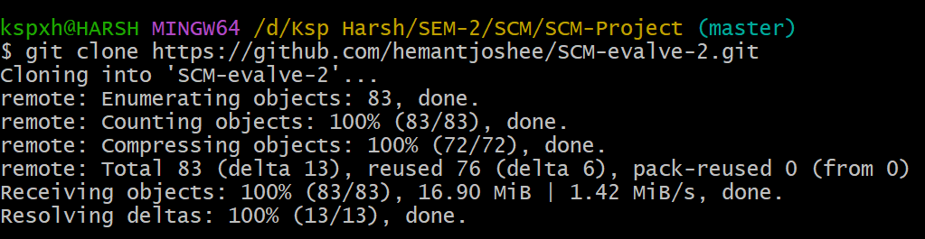

Installation & Setup
Steps to Set Up the Project :
Step 1: Cloning a GitHub Repository
Open your terminal or command prompt.
Run the following command to clone the repository.
Step 2: Navigate to the Project Directory
After cloning, navigate to your repository folder with this command:

Slide 7

Installation & Setup
Step 3: Open the Project in a Code Editor
Open the project in your preferred code editor
For Visual Studio Code, run the following command:

Slide 8
Usage Guide
For Users – Browsing and Registering for Events
STEPS:
Open the Website: Go to the website URL in your browser to access the event platform.
Browsing Events: Navigate through the homepage or use filters to explore various campus events and categories (e.g., Workshops, Sports, Cultural Fests).
Adding Events to Your Schedule: To register for an event, click on the “Register” or “Add to Schedule” button next to the desired event listing..
Proceeding to Confirmation: Once you're done selecting, go to your schedule or registration summary and click on “Confirm Registration” to complete the process.

Slide 9

Usage Guide
For Developers - Setting Up the Project
Steps :
Clone the Repository
Navigate to the Project Directory
Use Git to commit and push updates

Slide 10
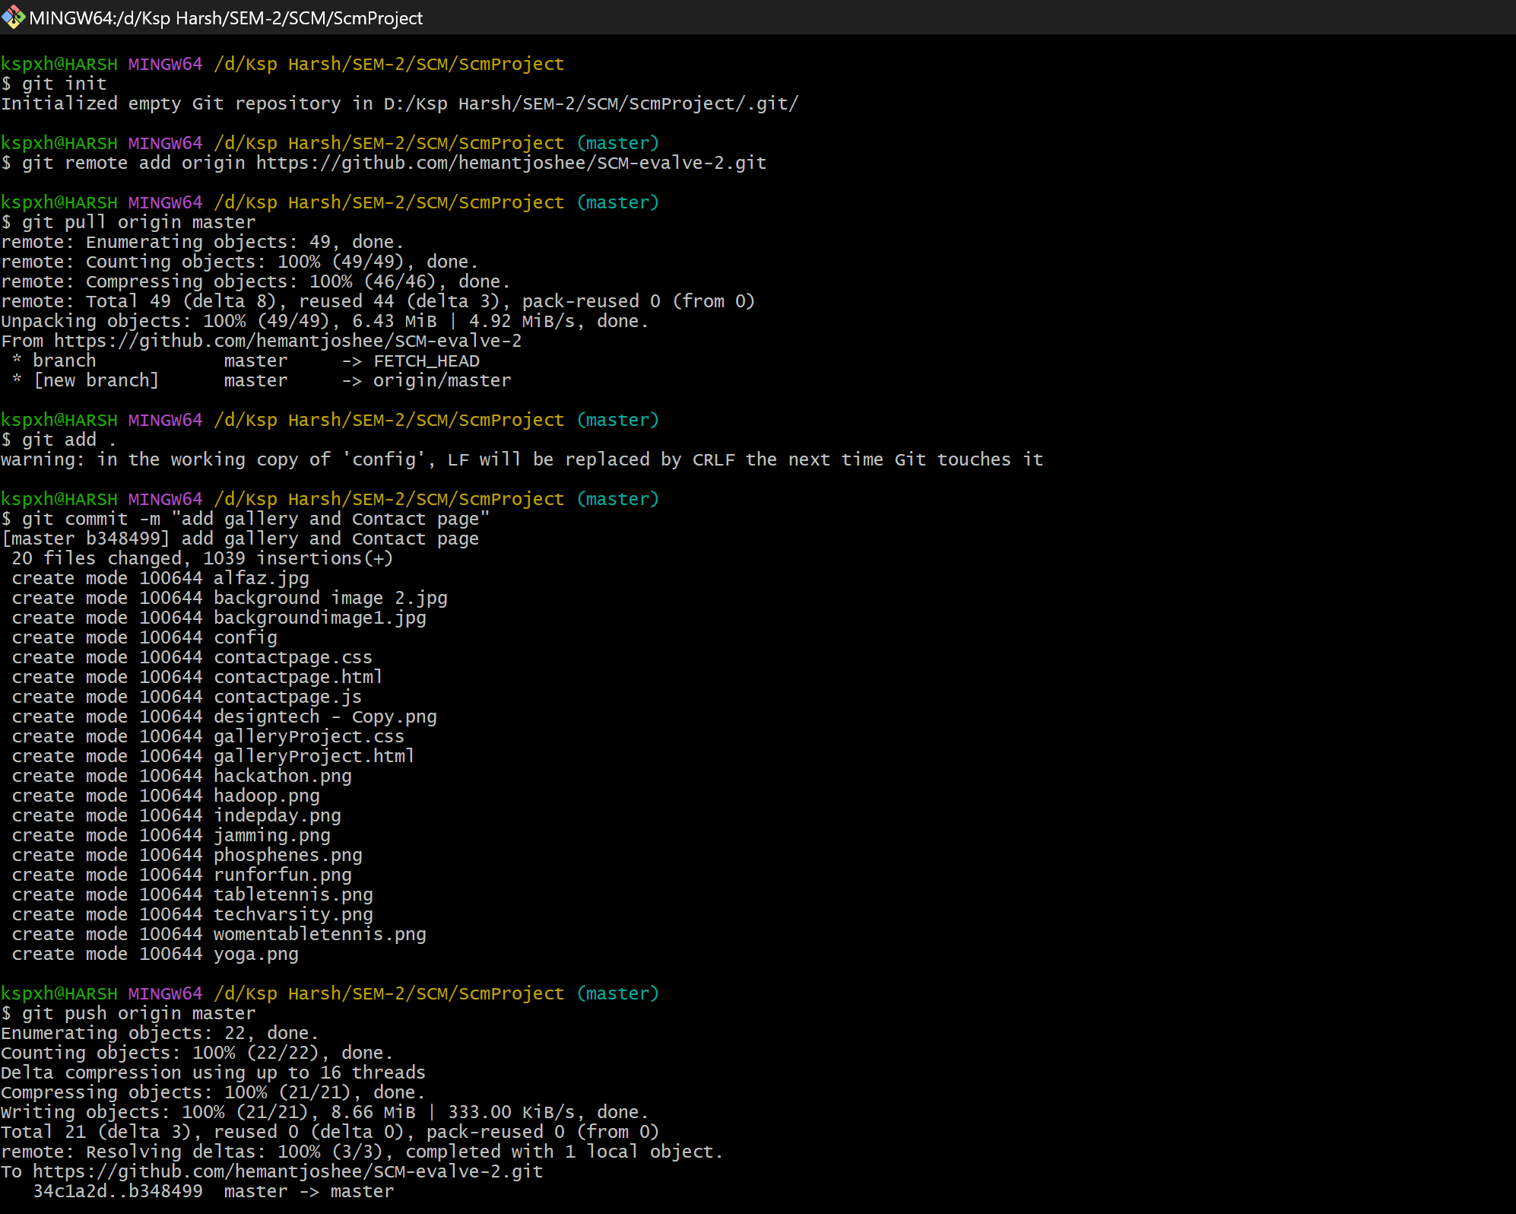
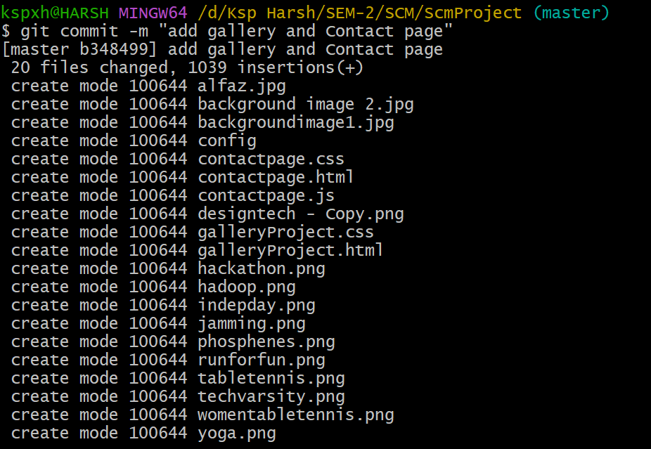
Version Control
Initializing Git in the Project :
Adding Files to Git :
Committing Changes :

Slide 11
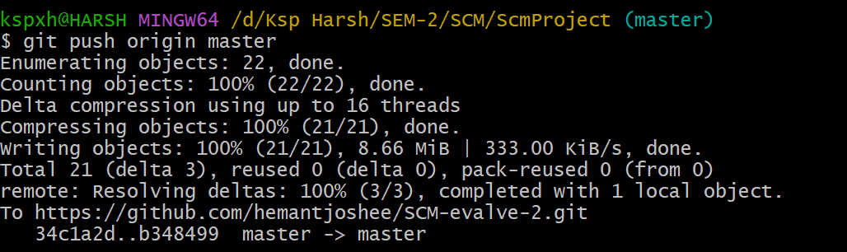
Version Control
Pushing to GitHub :
Updating Website with New Changes :
Make changes to the code.
Use git add . to stage changes.
Use git commit -m "Update description" to commit changes.
Use git push origin main to push the updated code to GitHub.

Slide 12
Features
Responsive Website
A responsive design ensures that the website adapts to different screen sizes and devices (desktop, tablet, mobile).
Key Benefits:
Mobile-friendly experience – Users can browse and register events.
Flexible layouts – The website automatically resizes elements to fit various screens.
Better SEO ranking – Google prioritizes mobile-friendly websites.
CSS Media Queries – Used to adjust styling for different screen sizes.
Hosted on GitHub Pages
GitHub Pages allows you to host your website for free directly from your GitHub repository.
Key Benefits:
No server setup required – Handles hosting, eliminating the need for third-party hosting services.
Automatic updates – Any changes pushed to the main branch are instantly reflected on the live website.
Free & secure – No additional cost, with HTTPS support for security.

Slide 13
Features
Version Control with Git
Git helps manage changes to your project by tracking modifications, allowing collaboration, and providing a backup.
Key Benefits:
Keeps track of all changes – You can revert to previous versions if needed.
Enables team collaboration – Multiple members can work on the same project without conflicts.
Branching system – Developers can work on separate features without affecting the main code.
Prevents accidental data loss – Every commit is a saved snapshot of the project.
Easy to Modify and Update
Your Online Book Store Website is designed for easy modifications and future updates.
Key Benefits:
Modular code structure – HTML, CSS, and JavaScript files are neatly organized for easy editing.
Version control integration – Any modifications can be tracked using GitHub.
Scalability – New features like user authentication, payments, and advanced filtering can be added later.

Slide 14

Project Highlights

Slide 15

Project Highlights

Slide 16

Project Highlights

Slide 17
Contribution
Members | Tasks Assigned
Member 1 (Repository Manager) | -Create GitHub repository & add collaborators Initialize Git in the project (git init) Set up GitHub Pages to host the website
Member 2 (Code Developer) | -Add project files to Git (git add .) Make the first commit (git commit -m "commit") Push code to GitHub (git push origin main)
Member 3 (Branch & Merge Manager) | -Create & manage new branches (git checkout –b NewBranch) Merge pull requests into main Resolve conflicts (if any)
Member 4 (Deployment & Documentation Lead) | -Enable GitHub Pages for hosting Verify the live website & report issues Write and maintain project documentation (README.md)
Member 5 ( Commit Manager ) | Update files & commit changes

Slide 18


